Slide 1
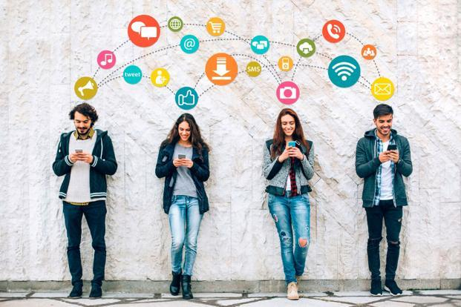
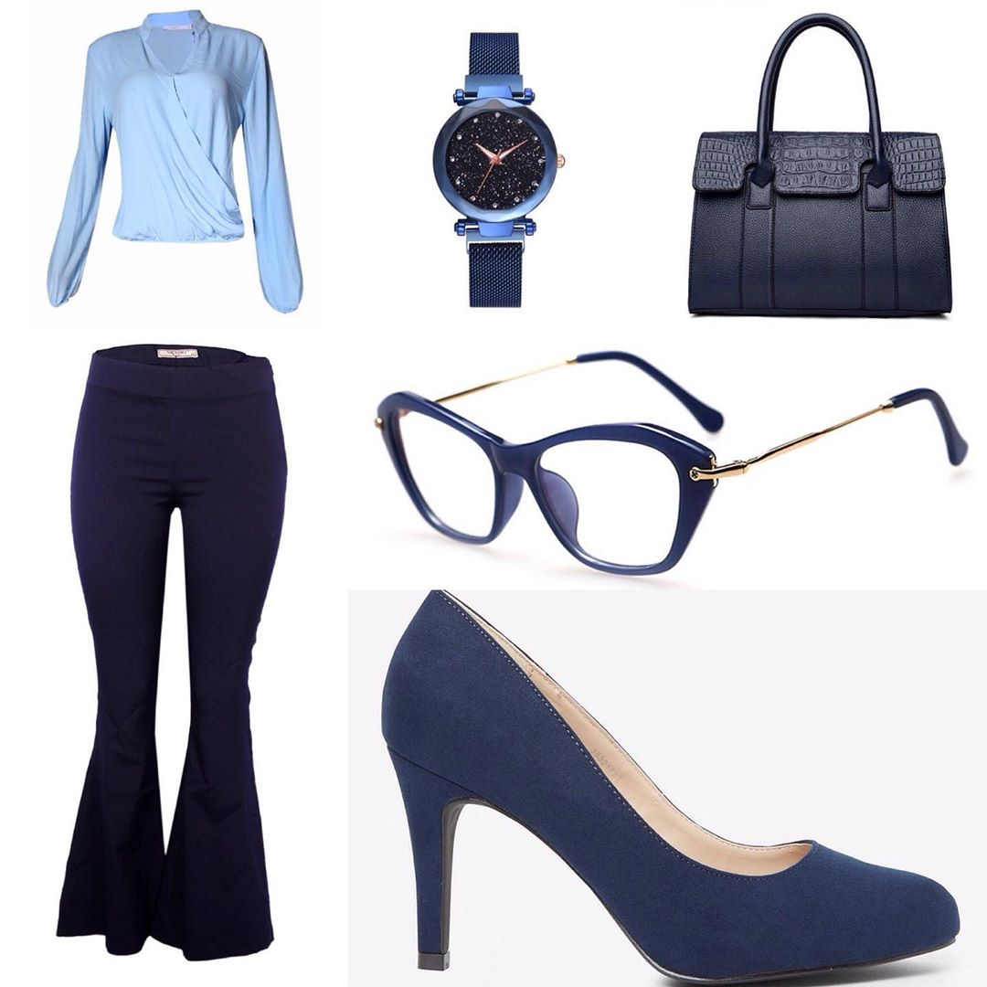
IMG2RECOMMENDER
An Introduction
Mindy Zhou

Slide 2
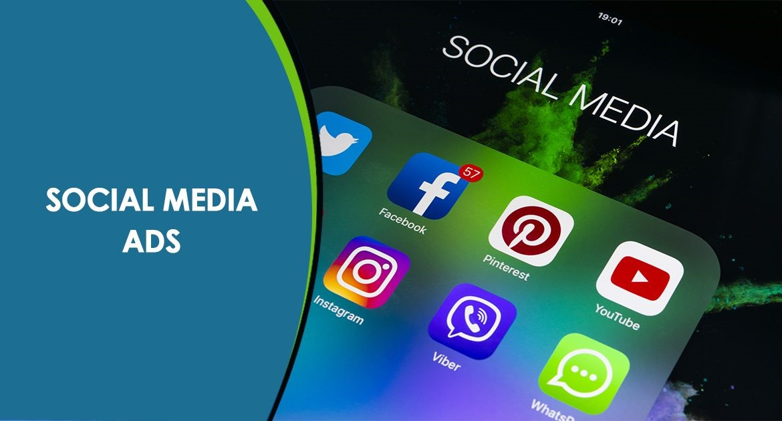

Business Understanding
Ad clicks: up to 3 dollars/click
Influencer Endorsements: up to 75,000 dollars per endorsement
COST, DATA, CROSS SITE TRACKING
IMG2RECOMMENDER
Benefits
Product Identifier
Targeted Customers
CNN
Targeted Ads

Slide 3




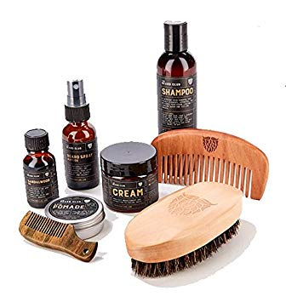
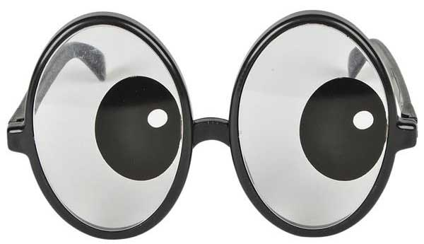


This Project: Step 1 FACE2HBE
Face Crop
Transfer Learning
Real Example Demonstration:
Face Crop
Initial Image
Recommendation
Note: Only recommend one product per person.

Slide 4

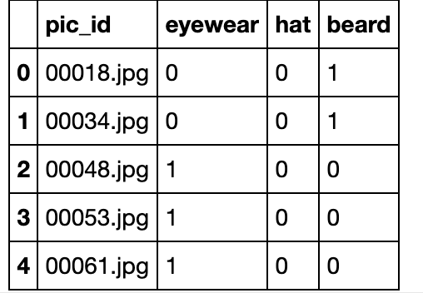
Data Understanding and Preparation
653 Images
Labeled Manually
Cropped Manually
Convert to Pandas Data Frame

Slide 5

Modeling and Application
Transfer Learning
hat versus no hat
Base Models
One Versus Rest
multi-classification
VGG16
ResNet50
eyewear versus no eyewear
beard versus no beard
Save 6 best models
Model Predictions
Using All Models
3 classifiers for VGG16
3 classifiers for ResNet50
Pick the label with the highest average prediction rate
Average Predictions for Each Label

Slide 6
Model Evaluation Results: ROC and AUC
VGG16 Hat
VGG16 Beard
VGG16 Eyewear
ResNet50 Hat
ResNet50 Beard
ResNet50 Eyewear

Slide 7

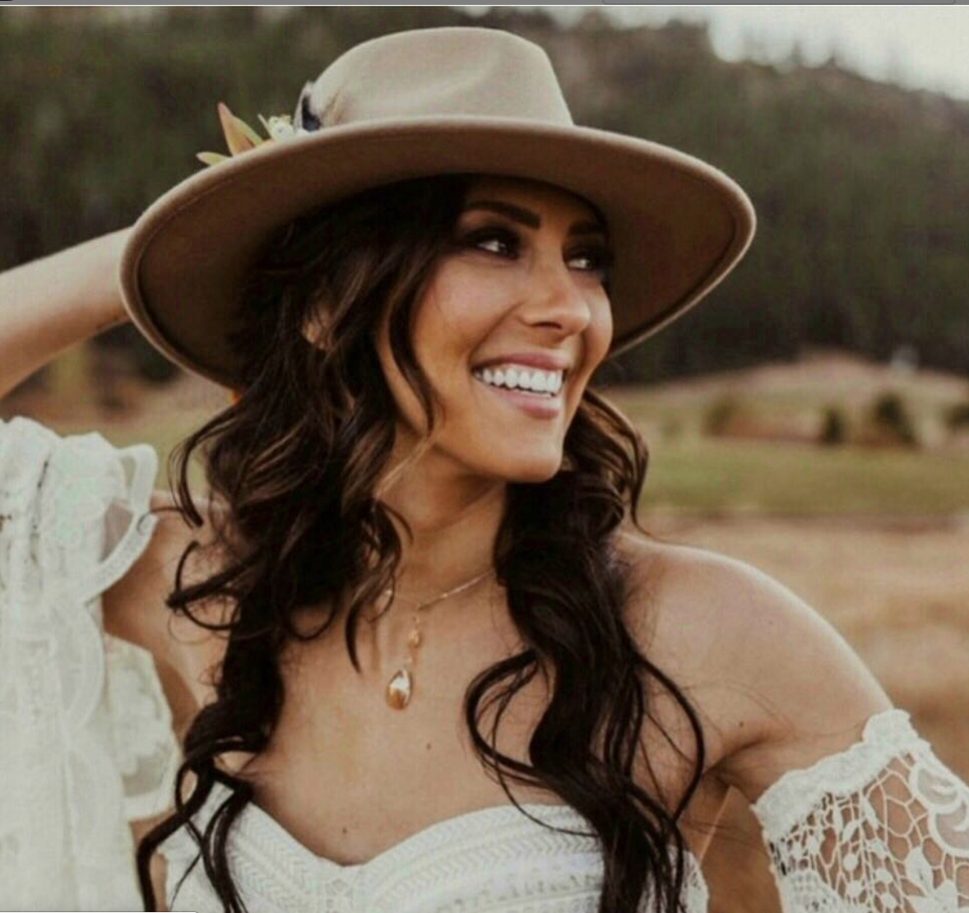

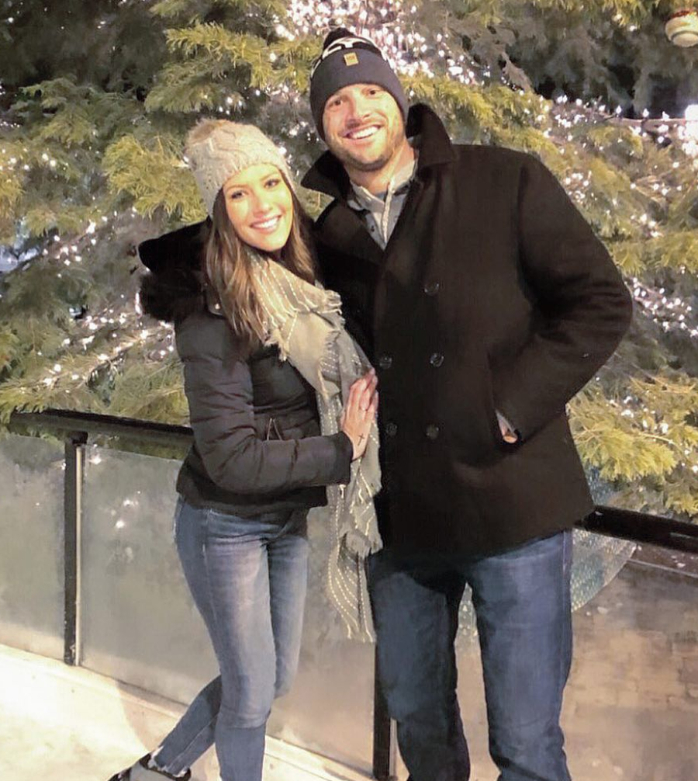
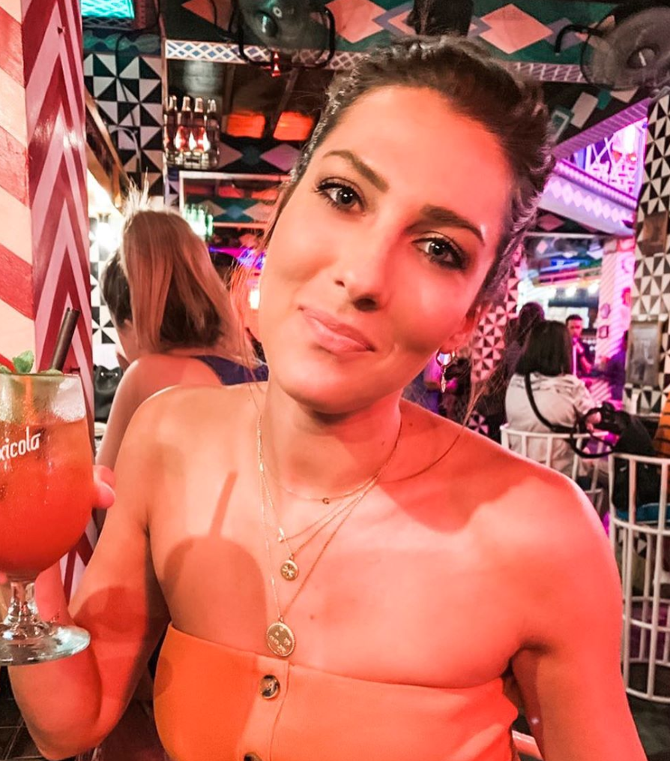
Deployment/demo:
Blog Post:
https://medium.com/data-science-blogs/deep-learning-for-social-media-marketing-7c197f0c729
Local program:
https://github.com/mzhou356/img2recommender/blob/master/python_files/product_recommender.py

Slide 8
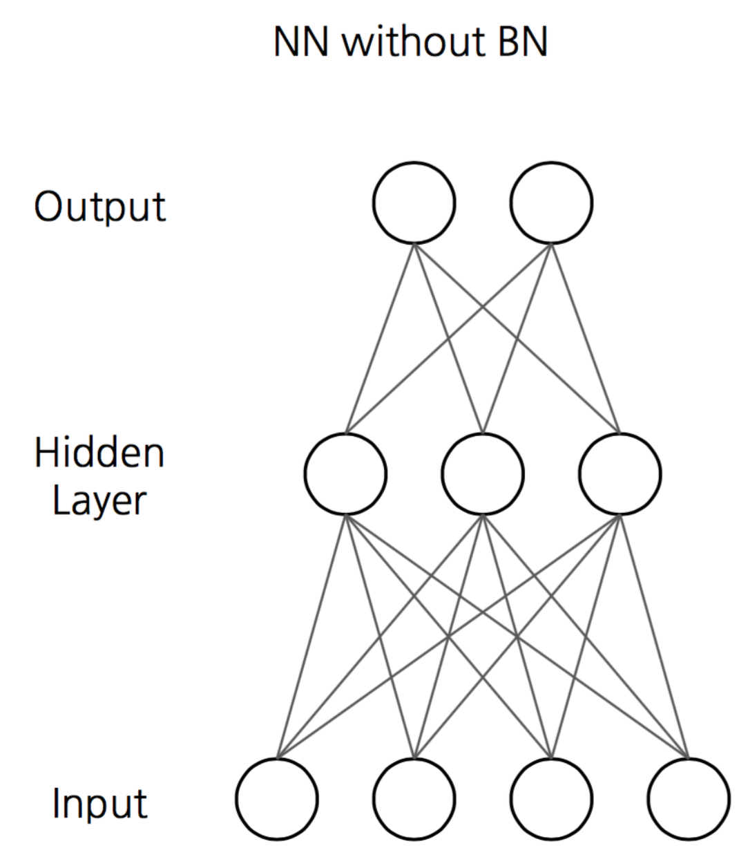
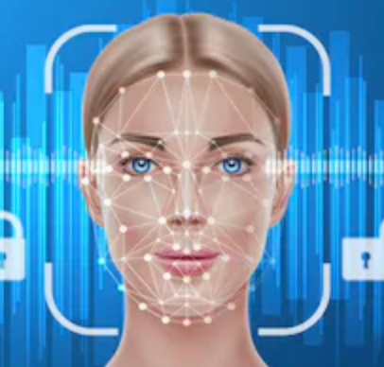
Future Plans
FACE2HBE
IMG2RECOMMENDER
Product or Person
Identifier
learning rate, momentum,
More Complex CNN Model
Train more layers
Transfer Learning to CNN

Slide 9
Questions?

Slide 10
Acknowledgements
Talented husband, Dr. Jason N. Dossett for setting up GPU and help with computer hardware.
Dr. Arun S. Maiya for forwarding helpful blog sources.
Thank Peter from July cohort for real example demonstration in slide 3.
Flatiron instructors and coaches for discussing and providing helpful insights.
Wonderful students at Flatiron for being positive and encouraging.

Slide 11
Sources:
https://www.pyimagesearch.com/2017/12/04/how-to-create-a-deep-learning-dataset-using-google-images/
https://blog.keras.io/building-powerful-image-classification-models-using-very-little-data.html
https://machinelearningmastery.com/check-point-deep-learning-models-keras/
https://machinelearningmastery.com/save-load-keras-deep-learning-models/
https://medium.com/@sidereal/cnns-architectures-lenet-alexnet-vgg-googlenet-resnet-and-more-666091488df5
https://towardsdatascience.com/understanding-and-coding-a-resnet-in-keras-446d7ff84d33
https://www.kaggle.com/suniliitb96/tutorial-keras-transfer-learning-with-resnet50
https://www.kaggle.com/pmigdal/transfer-learning-with-resnet-50-in-keras
https://towardsdatascience.com/transfer-learning-for-image-classification-using-keras-c47ccf09c8c8
https://github.com/ageitgey/face_recognition
https://karolakarlson.com/instagram-ads-cost-and-bidding/
https://www.esquire.com/lifestyle/news/a48223/celebrities-paid-ad-content-social-media/

Slide 12
Contact Info:
GitHub: https://github.com/mzhou356
Linkedin: https://www.linkedin.com/in/mindyzhou16/
Email: minzhou16@gmail.com
Medium: https://www.linkedin.com/in/mindyzhou16/

